Slide 1



15th Saeima elections
Scenario forecast
Providus · 3 October 2026

Slide 2
Key findings
28
5%
52
3–5%
seats for AS (United list party) in the base case
decides the shape of the Saeima
seats for AS+PRO+NA in the base case
chance AS (United list party) reaches 36 seats
Range 24–33 across scenarios. AS is the largest party in 92–99.9% of simulations.
JV passes in 67% of simulations, ZZS 63%, ST! 24%. A seven-party Saeima is the base case only ~44% of the time.
With PRO–NA political friction a majority exists in just 53–74% of scenario simulations. AS is in every viable majority.
36 is the post-1993 record (Latvijas ceļš). It needs ~29% of the vote; polls give AS ~23%.

Slide 3
Inputs and method
Inputs
Method
SKDS, 4–16 Sep: N = 2,035; margin ±2.7 pp on the decided base
Latvijas fakti, Sep: n = 1,018; ±3.8 pp, lower credibility, weight 20%
PolitPro: SKDS error in 2022 ≈ 2 pp (RMS), one cycle only
Early voting: 174,517 voters (11.20%) by 2 Oct, 2.8× the 2022 total
History: CVK results and turnout 1922–2022
5,000 simulations per scenario, poll error σ = 0.8 + 0.1 × support
Seats: Sainte-Laguë (divisors 1, 3, 5, 7…), 5% threshold, 100 seats, national allocation
Coalitions: minimal majorities under three sets of “red lines” (V1–V3)
Expert overlay: JV ≥ ZZS, both near 5% (S1–S4, S7)
Low–high: p5–p95 per party across seven scenarios
8 parties with largest documented support analysed; 14 party lists in the election
Source: SKDS / LSM 25.09.2026, Latvijas fakti, PolitPro, CVK, Providus calculations

Slide 4
Polls disagree most on SV/AJ and ZZS
SKDS is more precise: ±2.7 pp vs ±3.8 pp for Latvijas fakti on the decided base.
SV/AJ 14.2% in SKDS but 8.7% in Latvijas fakti; ZZS 6.9% vs 10.6%.
Total poll error ≈ 2× sampling error, so JV at 6.2–6.5% is statistically indistinguishable from the 5% threshold.
Base weighting 80/20 (SKDS / Latvijas fakti); 30/70 tested in S5.
Decided-voter shares recomputed from SKDS all-respondent figures. Source: LSM 25.09.2026, Latvijas fakti, Providus

Slide 5
Seven scenarios, one assumption each
Scenario | Poll weight SKDS / LF | Turnout | What it tests
S1 Base | 80 / 20 | 60.5% | Central estimate; JV 5.6% ≥ ZZS 5.4%
S2 SKDS 2022 bias | 80 / 20 | 60.5% | SKDS over-states “system” parties again (50% repeat)
S3 Low turnout | 80 / 20 | 56.5% | Interest like 2018; weaker Latgale turnout
S4 High turnout | 80 / 20 | 64% | Protest mobilisation (helps SV/AJ, LPV)
S5 LF more accurate | 30 / 70 | 60.5% | SV/AJ over-stated by SKDS; no JV/ZZS overlay
S6 AS maximum (ceiling) | 30 / 70 | 60.5% | Highest plausible AS: full 2022 bias + AS +3 pp
S7 AS minimum | 80 / 20 | 60.5% | AS −3 pp; JV, PRO, NA +1 pp each
S6 is a ceiling, not a forecast. Source: Providus model

Slide 6
AS leads everywhere; the rest is close
Seats from mean vote shares (deterministic); parties below 5% in the mean show no seats. Source: Providus model

Slide 7
Low–high seat range for every party
Party | Calculated theoretical low | S1 median | Calculated theoretical high
AS | 19 | 28 (23–35) | 39
LPV | 12 | 18 (13–22) | 23
SV/AJ | 8 | 17 (12–21) | 23
PRO | 8 | 13 (9–17) | 18
NA | 0 | 11 (8–15) | 16
ZZS | 0 | 7 (0–9) | 15
JV | 0 | 7 (0–10) | 11
ST! | 0 | 0 (0–7) | 10
AS: 19–39 seats. NA, ZZS, JV and ST! can all fall to zero seats.
Low = lowest p5 and High = highest p95 over S1–S7; 0 means below the 5% threshold in ≥5% of simulations. Source: Providus model

Slide 8
JV, ZZS and ST! live on the 5% line
In S1, JV passes in 67% and ZZS in 63% of simulations; both pass in 41%, neither in 12%.
Expert assumption: JV ≥ ZZS, both ~5.5%. Polls alone put ZZS (7.6%) above JV (6.4%) – S5 shows that case.
Why it matters: each failure adds wasted votes, raises AS’s seat bonus and removes a coalition partner.
ST! enters in 24% (S1) and 64% if the 2022 SKDS bias repeats.
Probability of passing the 5% threshold, share of 5,000 simulations. Source: Providus model

Slide 9
Early voting up 2.8×; turnout ~60–62%
174,517
early voters by end of 2 October (11.20%) vs 63,300 (4.11%) in all of 2022
54.6%
turnout in 2018, the post-1993 low. Estimate for 2026: 60–62% (range 57–65%).
High turnout tends to help SV/AJ and LPV; low turnout helps JV, NA, PRO.
Source: CVK historical data (Providus Excel, 1 Oct 2026); CVK advance voting data to end of 2 Oct 2026; Providus estimate

Slide 10
Arithmetic works; red lines constrain (probabilities)
Scenario | V1: any majority | V1: AS+PRO+NA | V1: AS+JV+ZZS+NA | V2: any majority | V3: AS+LPV+NA
S1 Base | 100% | 96% | 30% | 74% | 82%
S2 SKDS 2022 bias | 99% | 92% | 17% | 58% | 72%
S3 Low turnout | 100% | 96% | 41% | 90% | 86%
S4 High turnout | 99% | 95% | 18% | 53% | 79%
S5 LF accurate | 100% | 96% | 49% | 99% | 88%
S6 AS maximum | 100% | 67% | 7% | 97% | 52%
S7 AS minimum | 100% | 99% | 36% | 69% | 96%
V1 “cordon” – non-negotiable red line: AS, PRO, JV exclude LPV; everyone excludes SV/AJ and ST!. V2: V1 plus impact of PRO–NA political friction . V3: AS drops its line on LPV.
AS is in every viable majority. PRO–NA political friction cuts the chance of any majority to 53–74% in S1–S4 and S7, because JV and ZZS are then both needed.
Share of simulations in which a minimal majority (≥51 seats) exists. Source: Providus model

Slide 11
Most likely governments (probabilities based on calculations)
32%
A. AS + PRO + NA (+ ZZS or JV)
Arithmetically feasible, but only 52 seats in S1; PRO–NA political friction can tilt the outcome
20%
C. AS + PRO + ZZS (+ JV or NA)
Needs ZZS to clear the threshold
18%
E. Stalemate, snap elections 2027
Risk rises if JV misses the threshold or ST! enters
14%
D. AS + JV + ZZS + NA
Feasible in only 17–49% of simulations (S6: 7%)
8%
B. AS + LPV (+ NA or ZZS)
Arithmetic works; assuming AS drops its line on LPV.
8%
Other (minority governments etc.)
Providus expert assessment based on the simulations; probabilities sum to 100%

Slide 12
Can AS reach 36 seats?
Very unlikely: ~3–5%
~29% of the vote is needed at ~19% wasted votes; AS is at ~23%
S1 3.2%, wider errors 8.3%, ceiling scenario S6 22.6%
13% if both JV and ZZS miss 5%; 0.4% if both enter

Slide 13
36 seats needs ~29% of the vote
Seats ≈ votes ÷ (1 − wasted votes).
Records: Latvijas ceļš 1993 – 36 seats on 32.4% of vote; Vienotība 2010 – 33 on 31.2% of vote; Saskaņas Centrs 2011 – 31 on 28.4% of vote.
2022 shows the lever: JV won 26 seats on 19.0% of vote because 27.9% of votes were wasted.
Largest SKDS miss in 2022: 2.7 pp. AS needs +6 pp.
Share of votes wasted below the 5% threshold
Source: CVK results; Providus model. Stress case: ST!, MMN, LA at 4.9% each and others 10%

Slide 14
Russia-friendly voters: stable, now split
~19% on average since 1993 (range 7–28%): a stable voter pool.
SV/AJ today: 13.1% weighted (SKDS 14.2%, LF 8.7%) → ~17 seats (12–21).
Never a partner: the «non negotiable red lines/cordon" removes 15–18 seats; the rest need 51 of 76–85 seats.
Ostracism can raise support (van Spanje & Weber, 2019): an upside risk for SV/AJ.
2022 bar includes lists below the threshold (18.5%; 6.8% in parliament). 2026E: SV/AJ alone; all such parties together 12–21%. Source: Providus classification, CVK

Slide 15
Fragmentation weakens the winner
Winner’s vote share has been 23% or lower at every election since 2014 (19.0% in 2022).
Wasted votes hit 27.9% in 2022, so JV’s 19.0% became 26 seats.
Effective number of parties rose to 10.3 (2022), close to the 1931 level of 10.9.
Correlation 1993–2022: more parties ↔ weaker winner (r = −0.81), more wasted votes (r = +0.81).
2026E = S1 estimate (AS 22.9%, wasted ~19%). Source: CVK Excel 1922–2022, Providus calculations

Slide 16
Big parties rise, fall and disappear
10 elections, 5 winning party lineages: Latvijas ceļš, Saimnieks, Tautas partija, Jaunais laiks → Vienotība → JV, Saskaņa.
No winner has repeated more than three times; the winner keeps on average only ~55% of its previous vote.
Latvijas ceļš: 32.4% in 1993, 4.9% in 2002. Saskaņa: 28.4% in 2011, 4.8% in 2022.
Implication: AS and JV face the same pattern; AS’s own coalition of three parties adds fragmentation risk.
Lineages follow the CVK Excel. Gaps = party did not run. Source: CVK, Providus calculations

Slide 17
22 governments in 33 years
17.9
months: average life of a government (median 14.8)
Only 5 of 22 lasted 24 months or more (highlighted).
No government has served a full four-year term; the longest, Kariņš I, lasted 46.7 months.
Forecast implication: a fragile AS-led coalition (52 seats in S1) means government stability is the main risk, not the election result itself.
Months from appointment to resignation or replacement. Source: Providus Excel (governments sheet)

Slide 18

What to watch on election night and the following week
JV, ZZS, ST! at 5%: sets the number of parties and AS’s seat bonus
AS vs ~29%: the line for 36 seats
Turnout: >63% helps SV/AJ and LPV; <57% helps JV, NA, PRO
First signals: do PRO and NA rule each other out? does AS repeat its line on LPV?
Riga: Keep your eyes open on movements in Riga city governing coalition while parties negotiate national government coalition
Fallout from pre-election controversies of various party candidates

Slide 19

Calculations - caveats
Seats are allocated nationally, not in five constituencies; read party seat counts with ±2–3 seats of slack. Who passes 5% is unaffected.
Error model is calibrated on one election (SKDS 2022); no consistent publicly available data set available for prior past polling data (Providus 2026).
JV ≥ ZZS reflects the poll error ≈ 2× sampling error, so parties at 6.2–6.5% are statistically indistinguishable from the 5% threshold. The overlay shifts ~3 pp and changes AS seats and coalitions.
Latvijas fakti has no publicly available track record of political party polling over the last years; its weight is 20%.
S6 is a ceiling, not a forecast. Turnout effects on parties are assumptions.

Slide 20
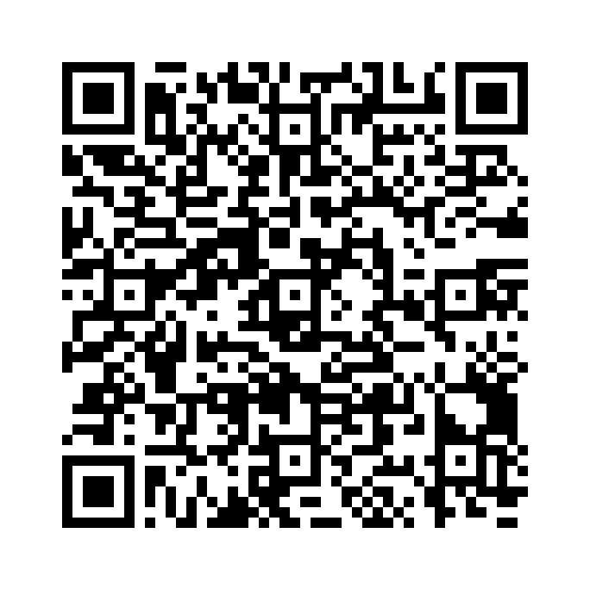
Support Providus' work
Providus is an independent think tank in Riga, Latvia working on public policy, good governance and the rule of law.
Your donation helps us keep producing independent, evidence-based analysis.
Bank transfer details
Recipient
Sabiedriskās politikas centrs PROVIDUS, No: 40003613479
Bank
Swedbank
SWIFT/BIC
HABALV22
IBAN
LV54HABA0551013220436
Scan with your banking app (SEPA/EPC QR)
Purpose
ziedojums PROVIDUS darbībai / Donation in support of Providus activities
https://providus.lv/en/contacts/

Slide 21



Thank you!
Sanda Liepiņa
Providus
sanda.liepina@providus.lv

